Slide 1
STACKS

Slide 2
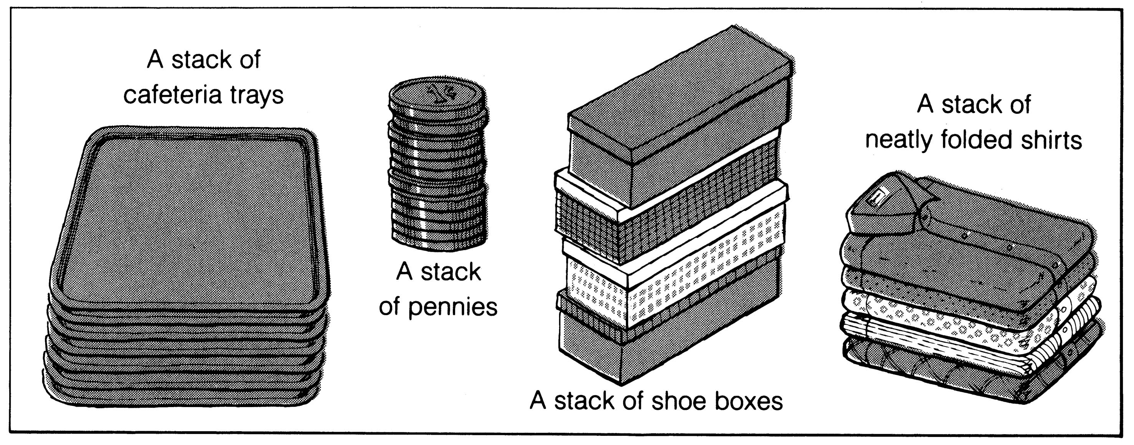
What is a Stack?
It is an ordered group of homogeneous items of elements.
Elements are added to and removed from the top of the stack (the most recently added items are at the top of the stack).
The last element to be added is the first to be removed (LIFO: Last In, First Out).

Slide 3
Operations Associated With The Stacks
Special terminology is used for two basic operations associated with the stacks:
“Push” is the term used to insert an element into the stack.
“Pop” is the term used to delete an element from the stack.
In particular, the elements are removed from the stack in the reverse order of that in which they were inserted into the stack.

Slide 4
The below figures shows the three ways of representing stacks.
Stack: AAA, BBB, CCC, DDD, EEE, FFF
FFF
EEE
DDD
CCC
BBB
AAA
AAA
BBB
CCC
DDD
EEE
FFF
1
2
3
4
5
6
N
TOP
TOP
TOP
AAA | BBB | CCC | DDD | EEE | FFF
1 2 3 4 5 6 N

Slide 5
BASIC STACK OPERATIONS
1.PUSH:
The push operation inserts an element at the top of the stack.
After the push operation, the element that has just been just been pushed onto the stack becomes the top.
Each push operation increses the number of elements on a stack by one.

Slide 6


Slide 7
PUSH ALGORITHM
PUSH(S,TOP,MAXSIZE,ITEM)-Given S be a one-dimensional array representing stack with MAXSIZE elements.The Variable TOP holds the array index of the element at the top of the stack.This algorithm inserts ITEM at the top of the stack.
1.[Check for stack overflow]
If TOP=MAXSIZE then
Write “overflow”
Return
[End of If Structure]
2.TOP←TOP+1 [Increment TOP]
3.S[TOP]←ITEM [Insert ITEM at the top of stock]
4.Return.

Slide 8
2.POP:
The pop operation on a stack is just reverse of the push operation.
In this we remove the element from the top of the stack and return it to the user.
If stack contains more then one element then after removing the top element from the stack ,the next older element in the stack becomes the top.
Each pop operation reduces the number of elements in a stack by one.

Slide 9
POP ALGORITHM
POP(S,TOP)-Given S be a one dimensional array maintaining stack and a variable TOP contains an index of the array element whose value is at top of the stack.This algorithm removes the top element from array S. Here,we use a local variable ITEM that holds the deleted element which is returned
1.[Check for underflow state of stack]
If TOP=0 then
Write “underflow”
Return
[end of if structure]
2.ITEM←S[TOP] [copy TOP element to ITEM]
3.TOP←TOP-1 [Decrement TOP]
4.Return (ITEM)

Slide 10
3.STACKTOP or PEEK
In some situation ,we just want to inspect the element at the top of a stack without actually removing it.
This is accomplished using the stacktop or peek operation.
The peek operation returns the element at the top of the stack without altering the stack.
After performing this operation ,there is no change in the number of elements in the stack.

Slide 11
PEEK ALGORITHM
PEEK(S,TOP)-Given S be a one-dimensional array maintaining stack and variable TOP contain an index of the array element whose value is at the top of the stack.This algorithm return the top element from the stack.
1.[Check for underflow state of stack]
If TOP=0 then
Write”underflow”
Return
[end of if structure]
2.ITEM←S[TOP]
3.Return(ITEM)

Slide 12
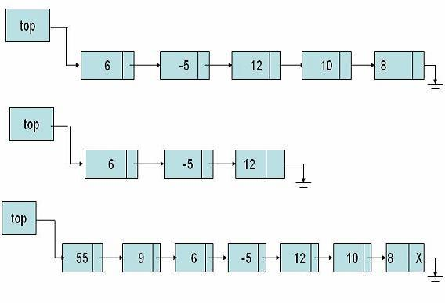
Linked Representation Of Stacks

Slide 14
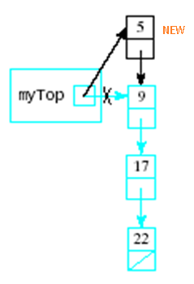
Push Operation On Stack Using Linked List
Algorithm: PUSH_LINK(INFO, LINK, TOP, AVAIL, ITEM)
[Available space?]
If AVAIL= NULL, then Write OVERFLOW and Return.
[Remove the first node from AVAIL list]
Set NEW:= AVAIL and AVAIL:=LINK[AVAIL].
Set INFO[NEW]:= ITEM. [Copies ITEM into new node.]
Set LINK[NEW]:=TOP. [New nod points to original top node of the stack.]
Set TOP=NEW. [Reset TOP to point to the new node of the top of stack.]
Exit.
The above procedure pushes an ITEM into a linked stack.

Slide 15
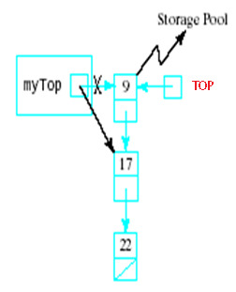
Pop Operation On Stack Using Linked List
Algorithm: POP_STACK( INFO, LINK, TOP, AVAIL, ITEM):Given a linked stack with pointer TOP pointing to first node of the linked list. The AVAIL pointer points to the first node of the availability list. This algo removes the top element of the stack and assign it to the local variable ITEM. Here ‘LOC’ is local pointer variable which points to deleted node.
[Empty List?]
If TOP=NULL, then
Write “Underflow”
Return
[End of If structure]
2. ITEM←INFO(TOP) [copies top element of the stack into ITEM]
3.LOC←TOP
4. TOP←LINK(TOP) [Reset TOP to point to the next node in linked stack]
5.LINK(LOC)←AVAIL
6.AVAIL←LOC
7.Return

Slide 16
APPLICATIONS OF STACKS

Slide 17
Arithmetic Operations
There are basically three types of notations that can be used widely to represent an arithmetic expression. These are as follows:
Infix Notation
Polish Notation(Prefix Notation)
Reverse Polish Notation.(Postfix Notation)

Slide 18
Infix Notation
The infix notation refers to the representation of the arithmetic expression in which the operator symbol is placed between its two operands.
Example: C=A+B.
With this notation we must distinguish between
(A+B)*C and A+(B*C)
By using either parenthesis or some operator precedence convention.

Slide 19
Polish Notation(Prefix Notation)
The polish notation refers to the representation of the arithmetic expression in which the operator symbol is placed before the operands.
Example: A+B
The above expression can be represented in polish notation as follows:
+AB
The conversion of the following infix expression into polish notation is as follows:
(A+B)*C= [+AB]*C=*+ABC
A+(B*C)=A+[*BC]=+A*BC

Slide 20
Reverse Polish Notation( Postfix Notation)
The reverse polish notation refers to the representation of the arithmetic expression in which the operator symbol is placed after the operands.
Example: A+B
The above expression can be represented in reverse polish notation as follows:
AB+

Slide 21
CONVERSION FROM INFIX TO POST FIX
INFTOPOS(I,P)-Given I be the infix expression and S be the stack that hold operators and parentheses.The top element of the stack S is represented by TOS.this algorithm converts the infix expression I into postfix output expression P.

Slide 22
1.Push “(“ onto S
2.Append “)” to I
3.Scan I from left to right and repeat steps 4 to 7 for each element of I while(S is not empty)
4.If an operand is encountered,append it to P
5.if “(“ is encountered,push it onto stack S.
6.if an operator © is encountered then
a) Repeat while (TOS is an operator with same precedence or higher precedence than ©)
i)pop TOS and append it to P [end of step 6a loop)
b)push © onto S

Slide 23
7.If “)” is encounterd then
a)Repeat while [TOS is not “(“]
i)pop TOS and append it to P
[end of step 7(A) loop]
B)remove “(“.Donot append it to P
[end of if structure]
[end of step 3 loop]
8.Return

Slide 24
When an operand is encountered as in in step I,iii,v,vii,x,xii,xv ,it is simply appended to the postfix expression and does not cause any change in the stack
When left parentheses is encountered it is pushed onto stack as in step ix
If right parentheses is encountered all the operator are popped from the stack and appended to the expression until left parentheses is encountered in stack, the left parentheses is also popped from stack as in xiii,xvi
If the input operator has a lower or equal precedence than one at top of stack then repeatedly perform pop operation on the stack and append each operator to the output expression until input operator with higher precedence than input operation is encountered ,step vi

Slide 25
Suppose we want to convert 2*3/(2-1)+5*3 into Postfix form,
Expression | Stack | Output
2 | Empty | 2
* | * | 2
3 | * | 23
/ | / | 23*
( | /( | 23*
2 | /( | 23*2
- | /(- | 23*2
1 | /(- | 23*21
) | / | 23*21-
+ | + | 23*21-/
5 | + | 23*21-/5
* | +* | 23*21-/53
3 | +* | 23*21-/53
 | Empty | 23*21-/53*+
So, the Postfix Expression is 23*21-/53*+

Slide 26
Practice Questions
A+B/C+D*(E-F)^G
a+b*c-d/e*f
(a+b*c-d)/(e*f)
(a+b)*c/(a+b*c)

Slide 27
WHY
Why to use these weird looking PREFIX and POSTFIX notations when we have simple INFIX notation?
To our surprise INFIX notations are not as simple as they seem specially while evaluating them. To evaluate an infix expression we need to consider Operators’ Priority and Associative property
  For example expression 3+5*4 evaluate to 32 i.e. (3+5)*4 or to 23 i.e. 3+(5*4).
To solve this problem Precedence or Priority of the operators were defined. Operator precedence governs evaluation order. An operator with higher precedence is applied before an operator with lower precedence.

Slide 28
Infix Expression Is Hard To Parse
Need operator priorities, tie breaker, and delimiters.
This makes computer evaluation more difficult than is necessary.
Postfix and prefix expression forms do not rely on operator priorities, a tie breaker, or delimiters.
So it is easier to evaluate expressions that are in these forms.

Slide 29
Due to above mentioned problem of considering operators' Priority and Associative property while evaluating an expression using infix notation, we use prefix and postfix notations.
Both prefix and postfix notations have an advantage over infix that while evaluating an expression in prefix or postfix form we need not consider the Priority and Associative property (order of brackets).
  E.g. x/y*z becomes */xyz in prefix and xy/z* in postfix. Both prefix and postfix notations make Expression Evaluation a lot easier.

Slide 30
Evaluation Of Postfix Expression
Add a right parenthesis “)” at the end of P.
Scan P from left to right and repeat steps 3 and 4 for each element of P until the “)” encountered.
If an operand is encountered, put it on STACK.
If an operator is encountered, then:
a. Remove the two top elements of STACK, where A is the top element and B is the next to top element.
b. Evaluate B operator A.
c. Place the result of (b) back on STACK.
[End of IF Structure]
[End of step 2 loop]
Set VALUE equal to top element on STACK.
Exit.
The above algorithm finds the VALUE of an arithmetic expression P written in postfix notation.

Slide 31
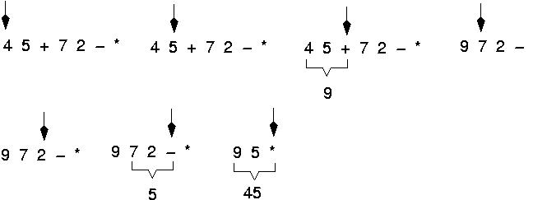
Example: postfix expressions

Slide 32
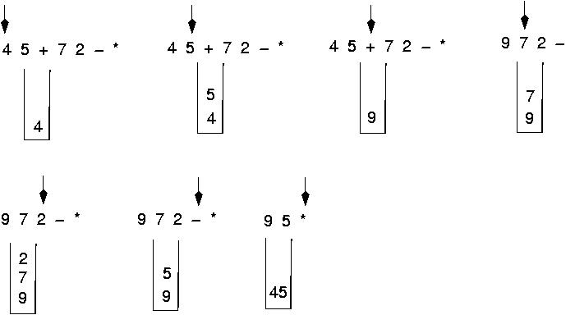
Postfix Expressions:
Algorithm using stacks

Slide 33
Practice Question
12,7,3,-,/,2,1,5,+,*,+
A,B,+,D,*,E,F,-,^(Where A=D=E=2 and B=F=3)
6,2,3,+,-,3,8,2,/,+,*,2,^,3,+
2,3,*,2,1,-,/,5,3,*,+

Slide 34
QUICK SORT

Slide 35
41,19,65,35,21,78,28,87,52,59
28,19,21,35,41,78,65,87,52,59
21,19, 28 35 41 78,65,87,52,59
19 21 28 35 41 59,65,52 78 87
        52 59 6578 87

Slide 36
4 3 6 9 2 4 3 1 2 1 8 9 3 5 6

Slide 37
One useful application of stack is to sort a number of elements using quick sort which is also known as partition exchange sort.
It is based on the idea that it is easier and faster to sort two smaller list than one large list.
It is based on divide-and-conquer strategy.
In this technique a given problem is divided into a number of more smaller sub problems and so on till a sub problem is not decomposable.
The general idea of quicksort is to select one element from a list of elements known as pivot element around which other elements will be rearraned.

Slide 38
Partitioning Procedure
PARTITION(S,N,BEG,END)-Given S is an array of N elements BEG and END contains lower and upper bound of the subarray on which partitioning process is applied. We have used local variable LEFT and RIGHT that contain the indices of the end elements of the subarray that are yet to be scanned. This algorithm divides the subarray with indices ranging from BEG to END into subarrays and return the location LOC of pivot element.

Slide 40
1.[Intilization]
LEFT←BEG,RIGHT←END,LOC←BEG
2. [Steps 2 to 4 perform scanning from left to right ]
Repeat while S[LOC]<=S[RIGHT] and LOC!=RIGHT
RIGHT←RIGHT-1 [Move towards left]
[End of while loop]
3.[Pivot element located?]
If LOC=RIGHT then
Return(LOC) [Exit from algo]
[end of if structure]
4. If S[LOC]>S[RIGHT] then
i) [Swap S[LOC] and S[RIGHT]]
a) TEMP←S[LOC]
b) A[LOC]←S[RIGHT]
c) S[RIGHT]←TEMP

Slide 41
ii) [Set new location LOC of pivot element after swapping]
LOC←RIGHT
[end of if structure]
5. [Steps 5 to 7 perform scanning from left to right]
Repeat while S[LOC]>=S[LEFT] and LOC!=LEFT
LEFT←LEFT+1 [Move towards right]
[End of while loop]
6. [Pivot element located?]
If LOC=LEFT then
return(LOC) [Exit from algo]
[End of if structure]

Slide 42
7. If S[LOC]<S[LEFT] then
i) [Swap S[LOC] and S[LEFT]]
a) TEMP←S[LOC]
b) S[LOC]←S[LEFT]
c) S[LEFT]←TEMP
ii) [Update LOC after swapping]
LOC←LEFT
iii) Goto Step2 [Repeat the steps]
[end of if structure]

Slide 43
QUICK SORT
QUICKSORT(S,N)-Given S be an array of N elements.This algorithm sorts the array S in ascending order.We have used two stack LOWER and UPPER that keeps track of first and last indices of subarrays that remains to be sorted respectively

Slide 44
1.TOP←0 [Stack is empty]
2[If S is not empty or has more than one element then push first and last indices of S onto stacks]
If N>=2 then
a)TOP←TOP+1
b)LOWER[1]←1,UPPER[1]←N
[End of If structure]
3.Repeat step 4 to 8 while TOP!=0 [till stack is not empty]
4.[Steps 4 and 5 pops first and last indices of subarray from stacks]
BEG←LOWER[TOP],END←UPPER[TOP]
5.TOP←TOP-1
6.[Divide array into two subarrays and LOC is location of pivot element]
LOC=Call PARTITION(S,N,BEG,END)

Slide 45
7.[If S is not empty and has elements then push left subarray onto stacks]
If BEG<=LOC-2 then
a)TOP←TOP+1
b)LOWER[TOP]←BEG,UPPER[TOP]←LOC-1
[End of If structure]
8[IF S has two more elements then push right subarray onto stacks]
If LOC+2<=END then
a)TOP←TOP+1
b)LOWER[TOP]←LOC+1,UPPER[TOP]←END
[End of IF structure]
[End of Step 3 loop]
9.Exit

Slide 46
Its complexity is O(nlog₂n)

Slide 47
TOWERS OF HANOI

Slide 48
Tower of hanoi is the most common recursive problem
The objective is to shift all disk from peg A to Peg C using Peg B.
The shifting of disks is restricted by following rules:
Only one disk can be shifted at a time.
Only top disk on any peg may be shifted to any other peg.
At no time can a larger disk be placed on a smaller disk

Slide 49
Tower of Hanoi

Slide 50
Tower of Hanoi

Slide 51
Tower of Hanoi

Slide 52
Tower of Hanoi

Slide 53
Tower of Hanoi

Slide 54
Tower of Hanoi

Slide 55
Tower of Hanoi

Slide 56
TOWERS of HANOI
MOVE(N,SRC,INT,DEST)-This algo shifts N(>0) number of disks from the source peg (SRC) to the destination peg(DEST) using the intermediate peg(INT).
1.If(N=1) then [shifting a single disk]
Write “ shift single disk from “ SRC “to” DEST
Else [Shifting N-1 disk recursively]
a) MOVE (N-1 , SRC, DEST ,INT)
b) DEST←SRC [Shift disk from SRC to DEST peg]
c) MOVE (N-1, INT, SRC,DEST)
[End of if structure]
2. Return

